Slide 1
Emotion supporter chatbot
Group 2

Slide 2
Introduction
The idea of our Chatbot is to help athletes and support them for a better mental health.
We tried in our chatbot to motivate them if they felt desperate.
We have made an analysis on a bigger scale in our ontology

Slide 3
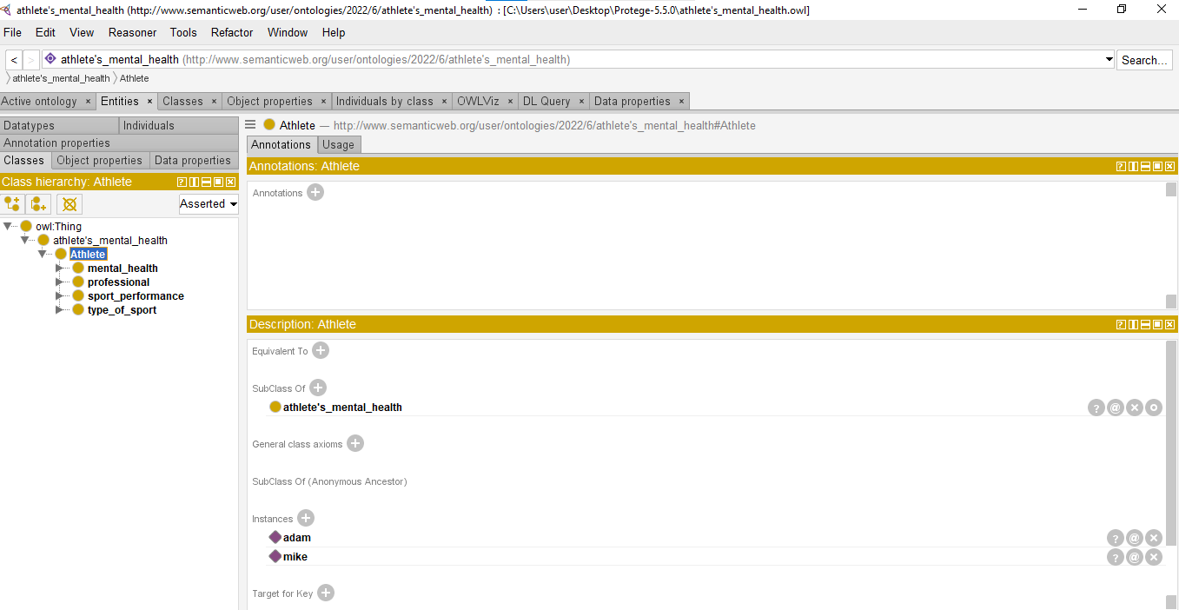
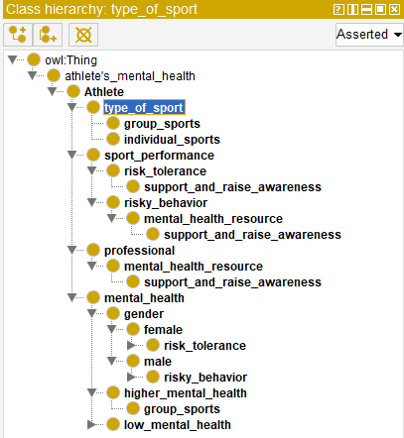
Ontology
Our main entities

Slide 4
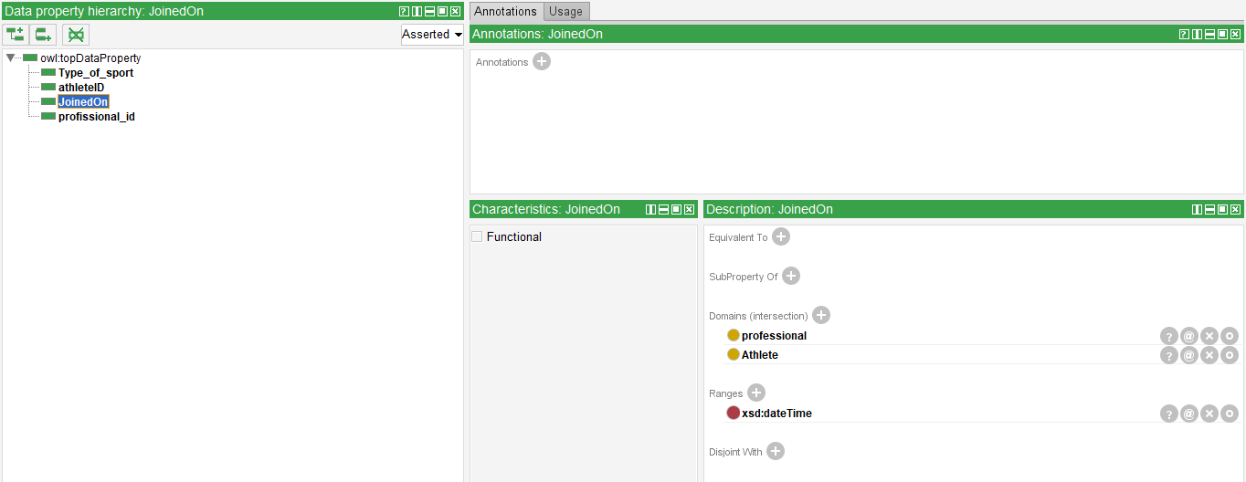
Data property

Slide 5
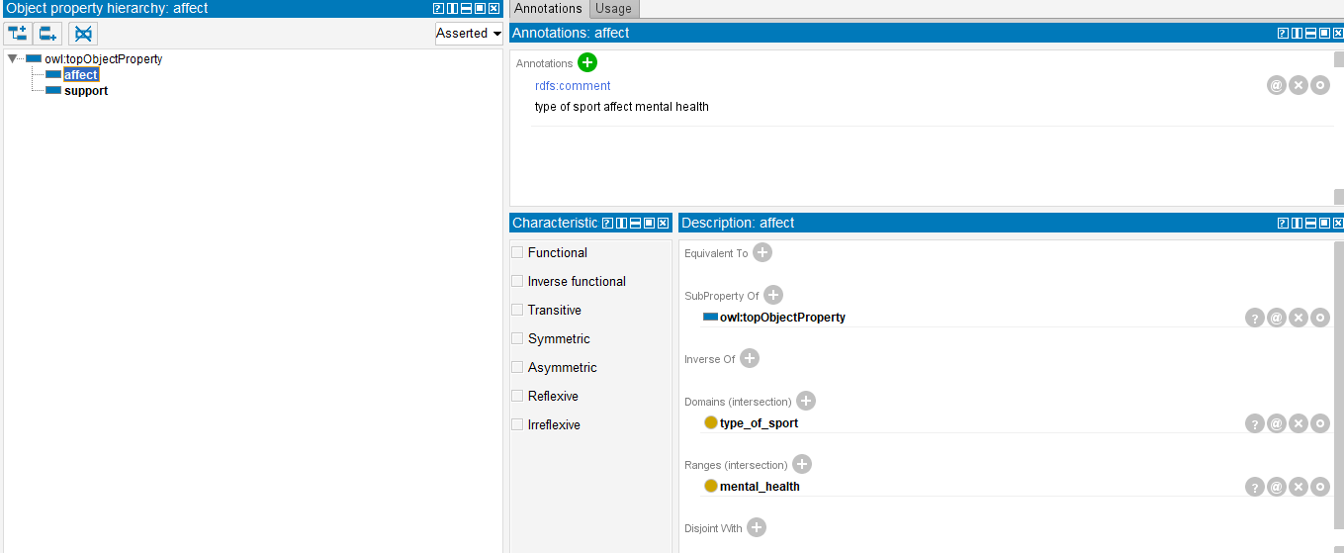
Object property hierarchy

Slide 6
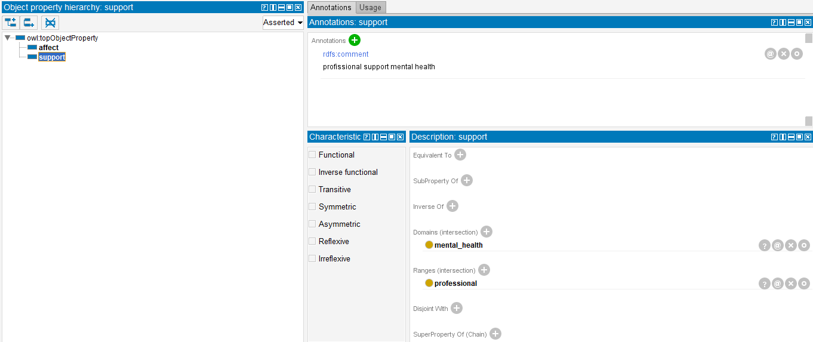
Object hierarchy

Slide 7
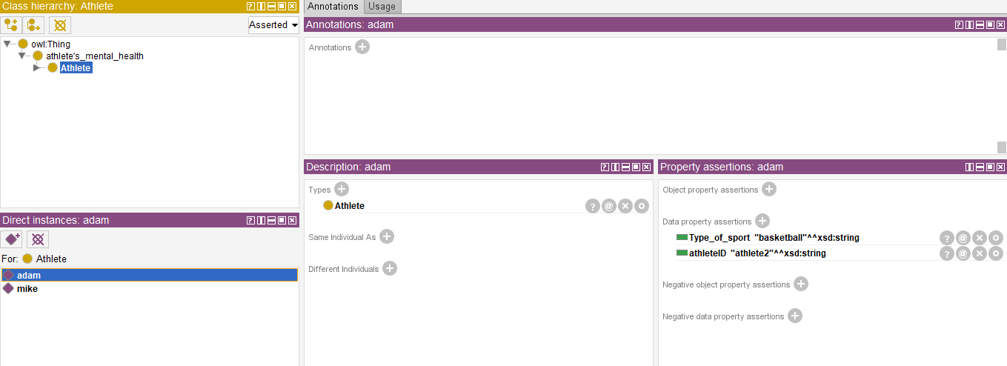
Individuals

Slide 8
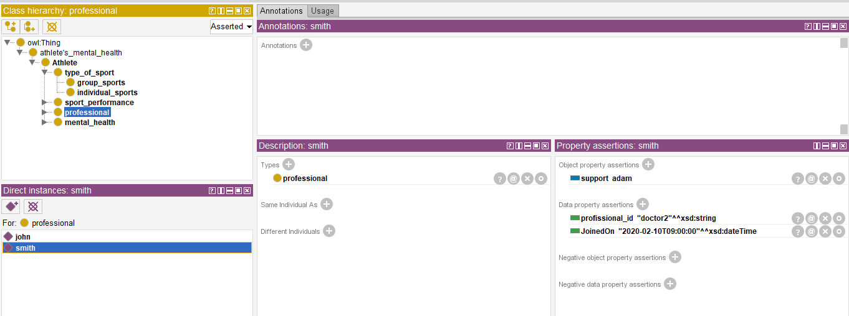
Individuals

Slide 9
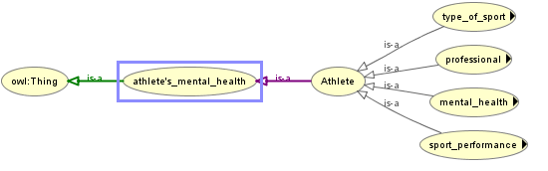
Owl visualizations

Slide 10
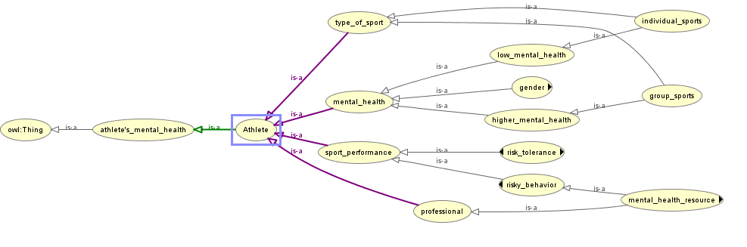
Owl visualizations. Cont

Slide 11
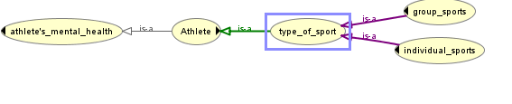
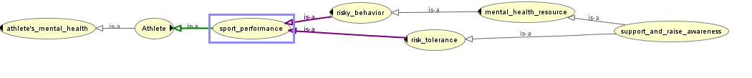
Owl visualizations. Cont

Slide 12
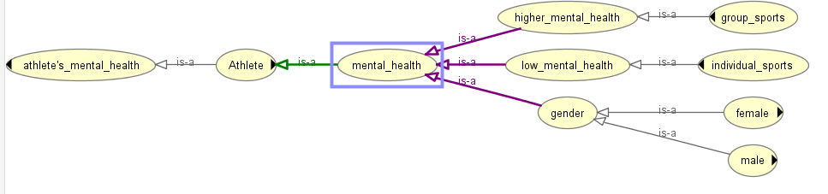
Owl visualizations. Cont

Slide 13
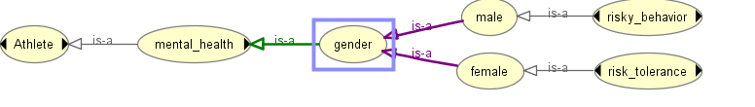
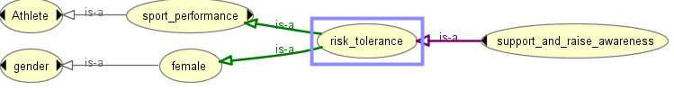
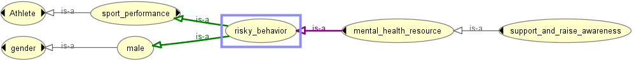
Owl visualizations. Cont

Slide 14
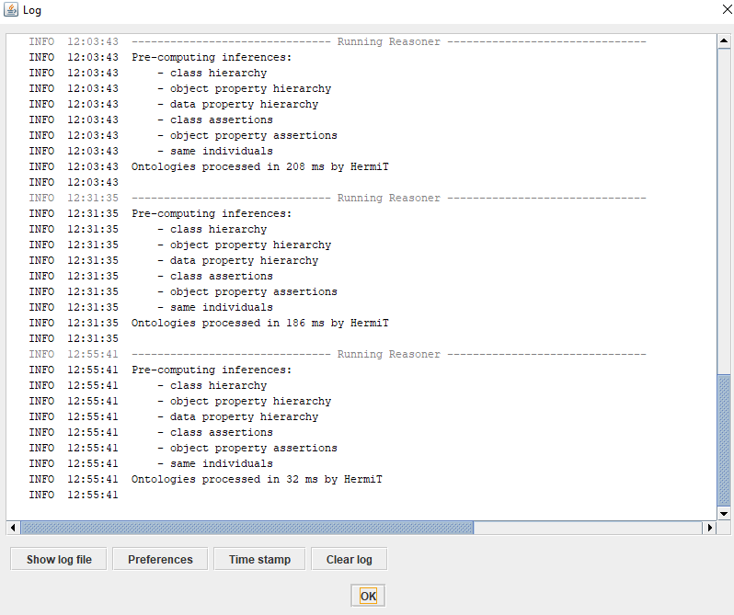
Reasoner
We run the reasoner to make sure that our ontology is doing is in a proper manner

Slide 15
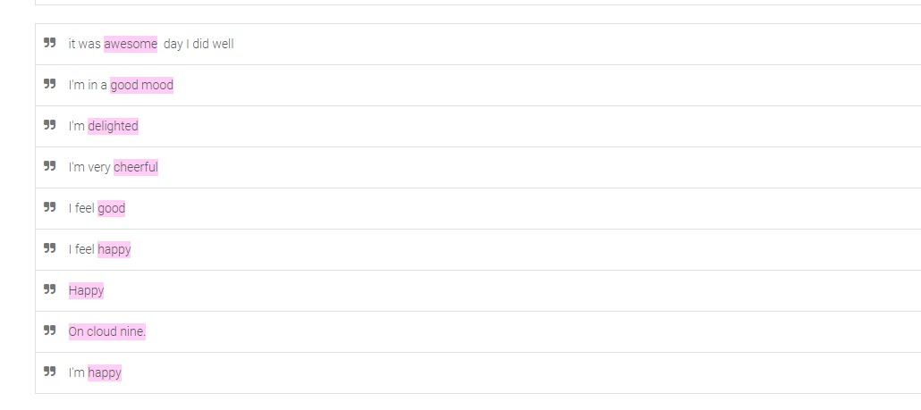
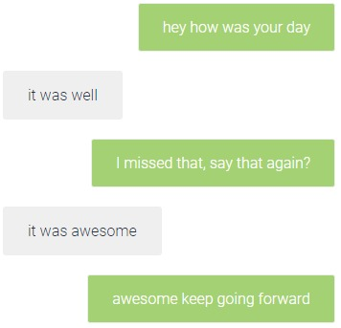
Chatbot: happy case

Slide 16
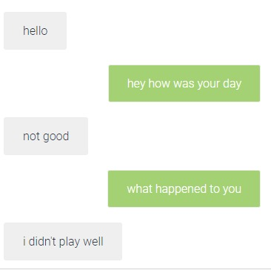
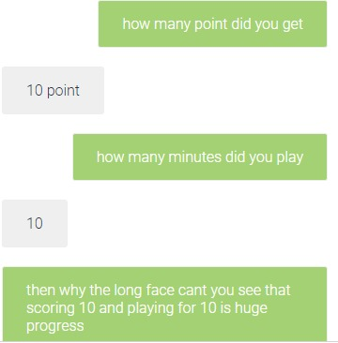
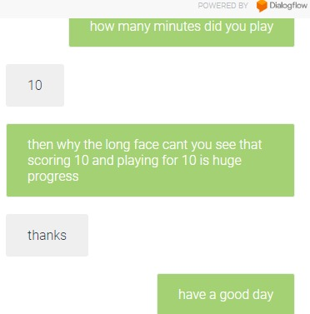
Chatbot: sad case

Slide 17
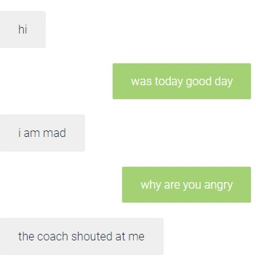
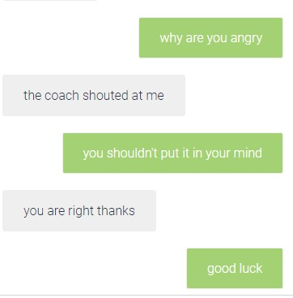
Chatbot: angry case

Slide 18
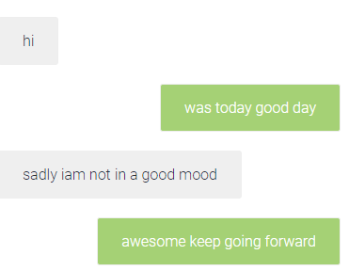
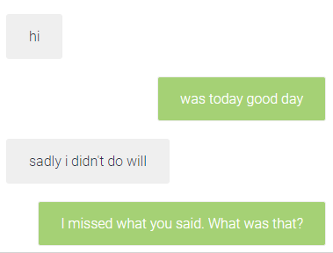
Evaluate
The chatbot had some point that were fixed and some that were not
Fixed not fixed

Slide 19
Thank you!

